Slide 1
Reviving DeepMind's DQN: A Replication Study
Briceno Benjamin, Cerutti Paolo, Delisle Thibault, Genin Victor
Østfold University College

Slide 2
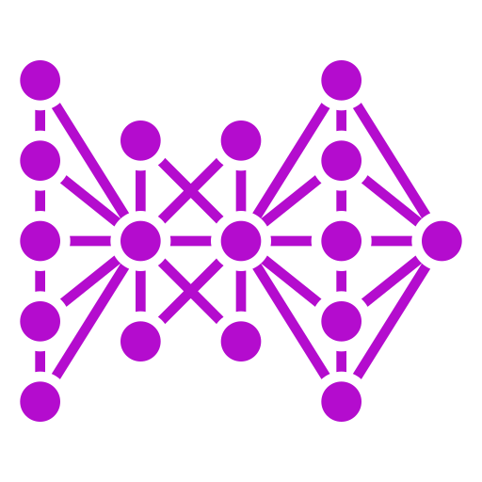
INTRODUCTION AND OBJECTIVES
Problem:
Lack of understanding in the application of pre-existing algorithms within neural networks.
Goal:
Recreating DQN algorithm for deep reinforcement learning while exploring challenges and intricacies

Slide 3
TABLE OF CONTENTS
01
02
03
04
05
06
INSPIRATION / RELATED WORKS
REINFORCEMENT LEARNING
DQN ALGORITHM
IMPLEMENTATION
RESULTS
CHALLENGES

Slide 4
INSPIRATION / RELATED WORKS
Playing Atari with Deep Reinforcement Learning
Human-level control through deep reinforcement learning
Implementation of the DQN method on some Atari game environments
Hyperparameters remain consistent across different games, showcasing the method's robustness
Outperformed previous methods and demonstrated generalization across different games.
Natural successor of the first paper
Approach involves training DQN model on 49 Atari games
Iterative modification of parameters to maximize results
Comparison of results with other algorithms and professional gamer

Slide 5
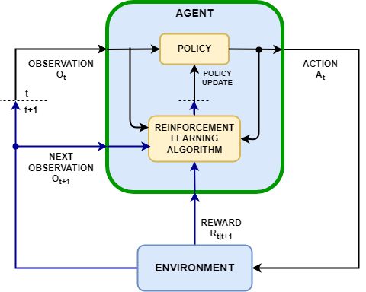
REINFORCEMENT LEARNING
Machine learning method based on a system of rewards and penalties
An agent interacts with the environment and adjusts its strategy according to the rewards and penalties it receives
The agent evolves its interactions between exploration and exploitation according to the policy
Notes:
Who of you knows what Reinforcement Learning is?
RL is a type of machine learning paradigm where an agent learns to make decisions by interacting with an environment.
The agent takes actions in the environment, and based on those actions, it receives feedback in the form of rewards or penalties.
The goal of the agent is to learn a strategy or policy that maximizes the cumulative reward over time.
Agent: The entity that makes decisions and takes actions in the environment. Environment: The external system or surroundings with which the agent interacts. State: A representation of the current situation or configuration of the environment. Action: The set of possible moves or decisions that the agent can take in a given state. Reward: Feedback from the environment that quantifies the immediate benefit or cost of an action taken by the agent. Policy: The probability the agent will take each action when in a particular state.
The goal is to select a policy that will maximize the expected return

Slide 6
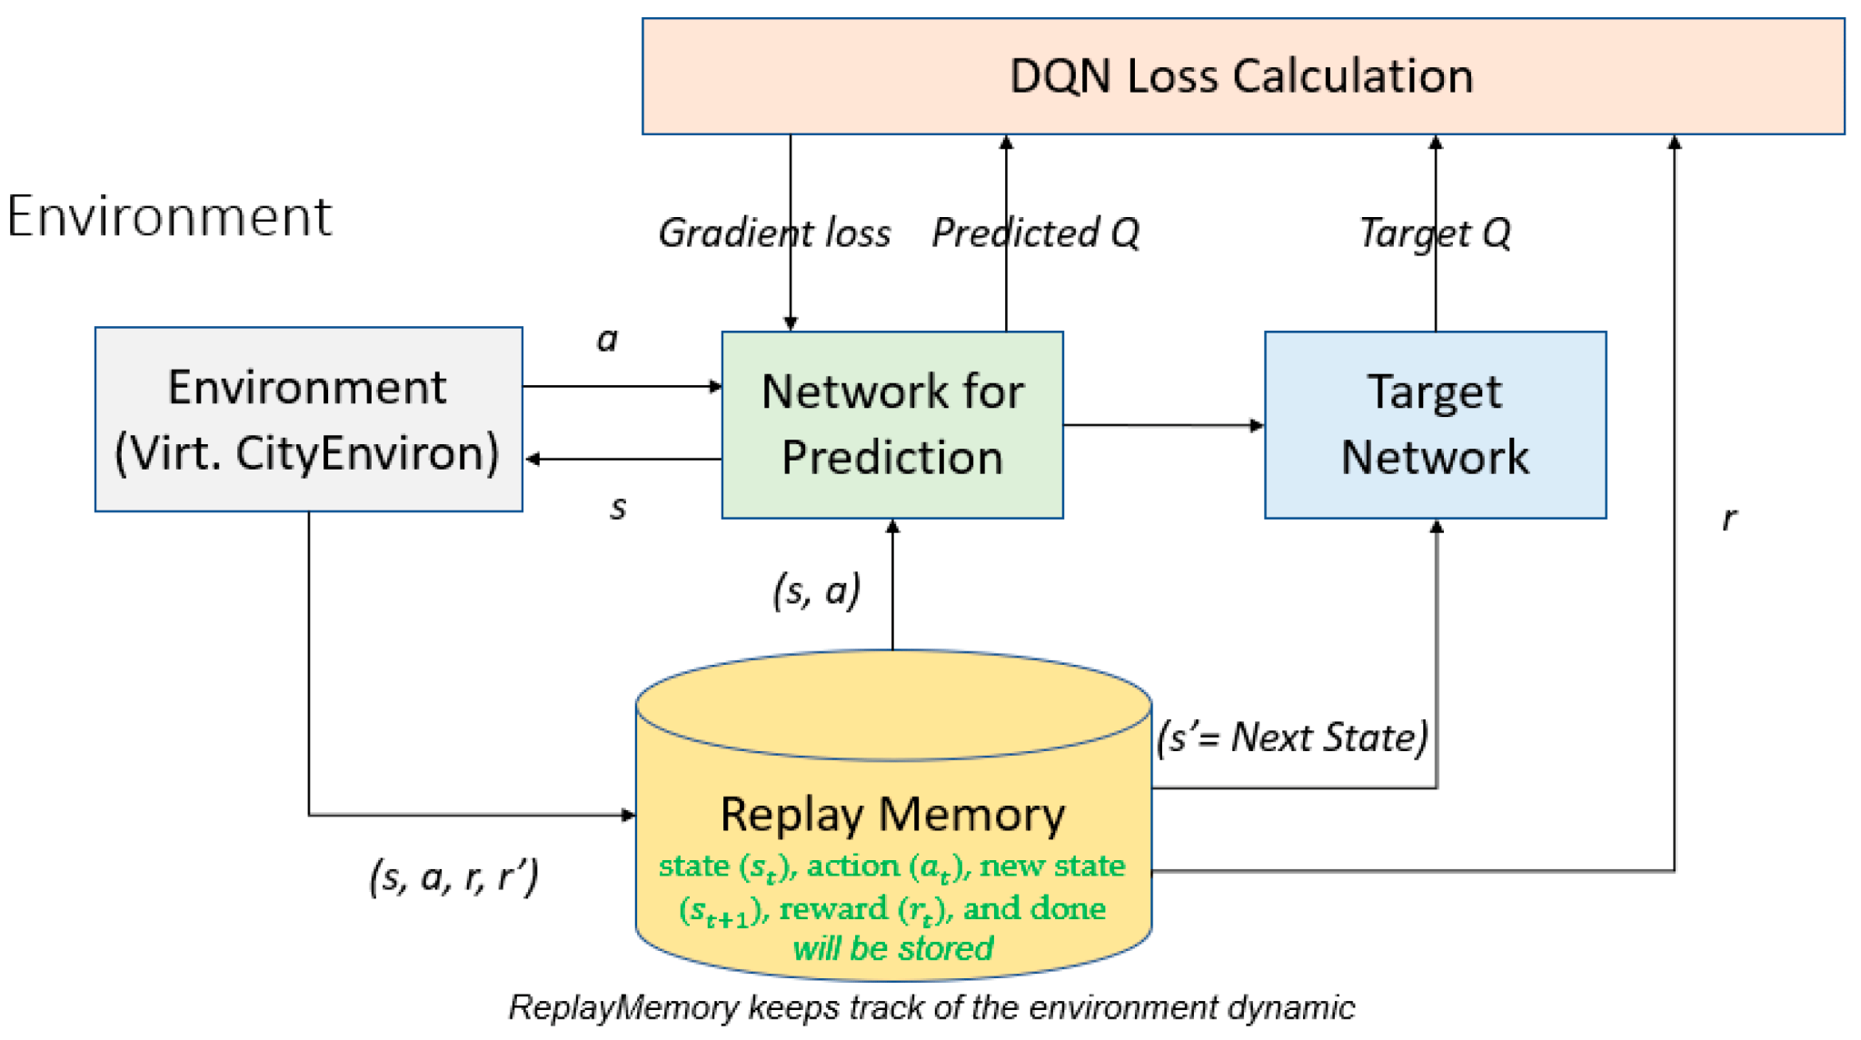
DQN (DEEP Q-NETWORK)
The DQN algorithm uses the principle of Q-learning, where Q-value is the expected reward based on a sequence of actions
It incorporates a deep neural network designed to approximate Q-values as closely as possible.
It retains the principle of exploration and exploitation
Notes:
The key idea behind DQN is to use a deep neural network, specifically a Q-network, to approximate the Q-function.
The Q-function, or the action-value function, represents the expected cumulative future rewards for taking a particular action in a given state.
The Q-network takes the current state of the environment as input and outputs Q-values for each possible action.
The agent then selects the action with the highest Q-value.

Slide 7
DQN - ADVANCED TOPICS
Experience Replay:
Store transitions (state, action, reward, next state) in a replay memory.
Randomly sample batches from the replay memory for training updates.
Helps break the temporal correlation in the data and improves stability.
Target Q-Network:
Introduce a separate target Q-network to stabilize training.
Periodically update the target Q-network with the parameters from the online Q-network.
Exploration-Exploitation:
Use an ε-greedy strategy for action selection during training.
Exploration (random actions) with probability ε, exploitation (choose action with highest Q-value) with probability 1-ε.
Reward Clipping:
Clip rewards to a range [-1, 1] to improve stability during training.
Notes:
DQN uses a technique called experience replay, where the agent stores and randomly samples from past experiences (transitions) to break the temporal correlations in the data. This helps stabilize and improve the learning process. Additionally, DQN employs a target network to update the Q-network more reliably.
The training objective of DQN is to minimize the difference between the predicted Q-values and the target Q-values, which are updated using the Bellman equation—a fundamental equation in reinforcement learning.

Slide 8
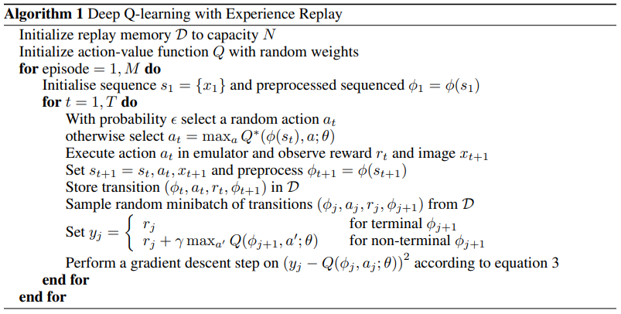
DQN - PSEUDO CODE
Notes:
We begin with initialization: setting up a memory bank 'D' and an action-value function 'Q' with random weights—essential foundations for our agent's learning process.
Now, let's delve into the main loop. We traverse episodes (represented by 'M') and time steps ('T'). At each step:
We decide whether to explore with a random action ('at') with probability 'epsilon' or exploit knowledge by selecting the action maximizing our current understanding ('at = maxa Q∗(φ(st), a; θ)').
Executing actions in the emulator provides rewards ('rt') and images ('xt+1'), shaping the agent's experience.
We store these experiences in 'D' using the transition tuple ('φt, at, rt, φt+1').
To efficiently learn from these experiences, we sample random mini-batches of transitions ('φj, aj, rj, φj+1') from 'D'.
The learning signal 'y' is constructed based on whether the next state is terminal or not. The signal 'y' serves as the target value for updating the Q-function during training.:
If terminal, 'yj = rj, Here, 'γ' represents the discount factor, which determines the importance of future rewards. It scales the impact of future rewards, emphasizing the importance of immediate rewards over distant ones..'
If non-terminal, 'yj = rj + γ maxa' Q(φj+1, a'; θ). Here, 'γ' represents the discount factor, which determines the importance of future rewards. It scales the impact of future rewards, emphasizing the importance of immediate rewards over distant ones..'
Finally, we perform a gradient descent step to update our Q-function, honing our agent's decision-making abilities.The objective is to minimize the squared difference between the predicted Q-value and the target Q-value.

Slide 9
IMPLEMENTATION - CART POLE
Actions and Observation space
Actions:
0: Push cart left
1: Push cart right
Observation Space:
Cart position
Cart velocity
Pole angle
Pole angular velocity
Rewards:
Reward of +1 for every step taken, max 500

Slide 10
IMPLEMENTATION - CODE
For the neural network, 2 classes:
DQN: The actual neural network
3 layers (128 nodes)
Activation function: rectified linear unit
DQNAgent: The neural network updater
Epsilon-greedy update
Hyperparameters such as the discount factor (0.95)
For the neural network creation, we used the Pytorch library
For the environment, we used the Gymnasium library
Environments such as atari games

Slide 11
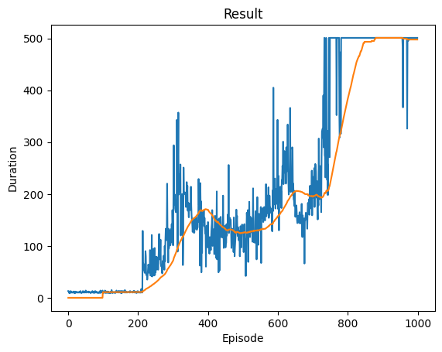
RESULTS
The algorithm is a success : it learned how to play perfectly the CartPole game
It obtains the maximum score after around 800 episodes
The ideal is to achieve the same performance, but quicker
Amount of exploration/exploitation visible on the graph

Slide 12
FUTURE WORK
CHALLENGES
Numpy implementation
Other games: breakout and pong
Trying other algorithms
Understanding of backgrounds and algorithms
Big amount of tests and debugs
Finding best parameters

